Slide 1
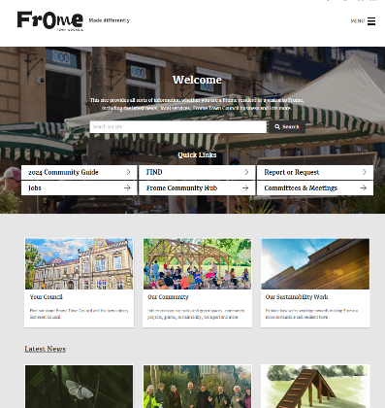
CPC Website I Background Summary
Current site - https://www.claygateparishcouncil.gov.uk/
Objectives
  Deliver a more engaging and easy-to-navigate site for Claygate residents, to find out all the information they need from the Claygate Parish Council
  Use imagery to create easy, clickable sections, rather than reems of text and drop down menus
  Engage all areas of the community, including younger members
Examples of Parish Council sites, that deliver against our objectives
  https://www.frometowncouncil.gov.uk/

Slide 2
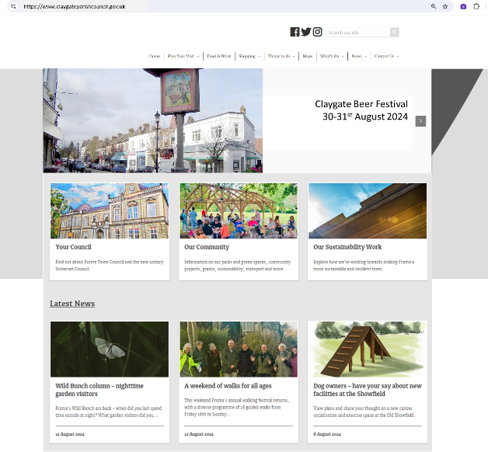
CPC Website I Preferred Site Layout
Home page Top Menu:
  Written menu at top of page showing the below menu options from “This is Claygate” onwards
1

Slide 3
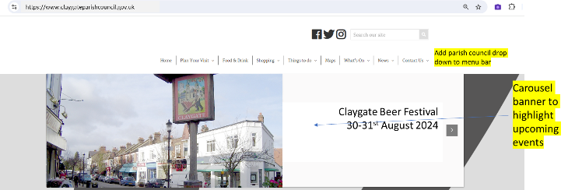
CPC Website I Preferred Site Layout
Home page top carousel banner
  Below top menu, to showcase upcoming events and/or message about what CPC delivers for you
  E.g.
    1 – Upcoming events
    2 – we are here for you to listen to your views and act on your behalf
    2 – we have a strategic role as well as providing a set of practical core services for the village
    3 – we care about Claygate and its community
2

Slide 4
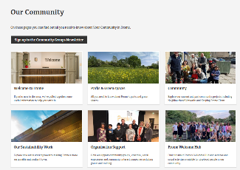
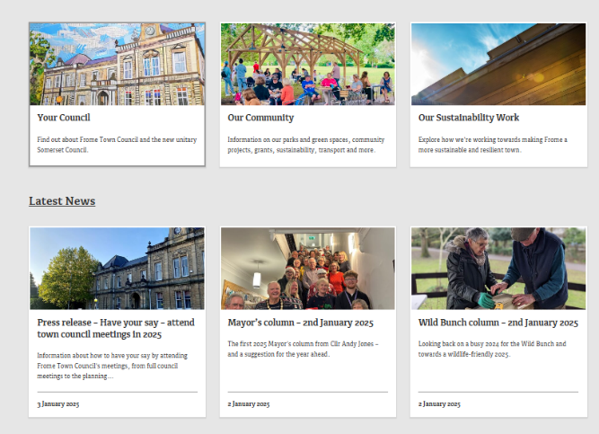
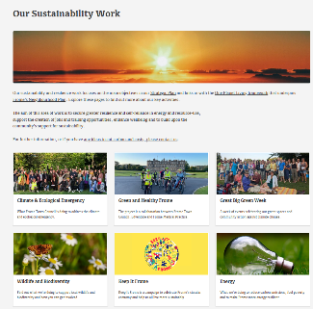
CPC Website I Site Layout
Home page Image tiles (below carousel banner)
  Image Tiles with text, below carousel banner, creating a photo-based menu format
    The 8 menu options with pictures and sub-menu’s (see slides 5-6)

Slide 5
CPC Website I Site Layout
8 Menu Options:-
About Us (Photo of the full council all together)
Council Members (photo of each plus existing committee membership plus a biography)
Remit (Charter document)
Governance (photo of people meeting) pdf of governance also shown once clicked on
Achievements (quarterly Achievements Slides in PDF form)
Policies (written document with a pen)
Services (photo of recent community event we arranged e.g. Brian Rhodes cup/village meeting)
Existing Services shown as pictures which you can click on to get a description e.g
Planning (picture of some plans on a table)
Environment (picture of woodland/Claygate Common)
Consultations (Showing people talking) - there is a button with a photo per consultation – we need to add recent ones such as NPPF and the recent such as NPPF and the recent one from EBC about Community Consultation
Hanging Baskets/Troughs (photo of a hanging basket),
Highway Garden Sites (photos of the sites and explanation of what we do with them)
Remembrance Planning (Picture of our Cenotaph),
Grants (Money Notes),
Litter Picks (Photo of a recent litter pick) and article
The Courier (Photo of Courier hanging out of door) - Organised by year and then under each year by issue but with photo pdf of the front of each issue
Brian Rhodes Cup (picture of most recent person to receive it and some verbiage on them),
Village Meeting (photo of a recent village meeting)

Slide 6
CPC Website I Site Layout
8 Menu Options:-
Services (photo of recent community event we arranged e.g. Brian Rhodes cup/village meeting)
  New Initiatives such as:
    Weeds and Detritus (picture of a weedy road) article about this copied from Courier?
    Claygate The Way Forward (perhaps a photo from a meeting in the church?) article about this (copied from Courier)
    Local Plan work (article on what is going on copied from Courier)
    Claygate Centre and article on how we have been involved (copied from Courier)
    Soldier Biographies (Picture of a silhouette in situ in Claygate) – Haldeigh’s article about this work
    Village Sign Replacement (Picture of the new sign in situ) – article about this
    Bench for the Parade – article about this
Meetings (showing people round a table meeting)
  Organised so there is one button per year with the year number on it with a memorable photo from the last 5 years of something that happened in that year
  Tabular format of meetings and docs within a year is fine as per current website
Finances (Showing cash/money photo)
  Accounts by Year (Photo for each type of statement up to 12 docs )
News (someone talking through a loudspeaker)
  Photo for each piece of news showing with a title under it (up to 10)
Contact Us and GDPR Options for mailings (Showing photo of a letter being posted)
“This is Claygate” link to another village website (this can be added later once developed and does not need to be on the first version of the website)

Slide 7
CPC Website I Site Layout
Existing content
  Please refer to the content already on the website, which should also be included somewhere:-
    History of Claygate / Heritage trail / Map / Events / Local Organisations / Claygate Community Pool
    Quick Links
    Contact Us / Facebook Page / Write to us
    Village Design Statement

Slide 8
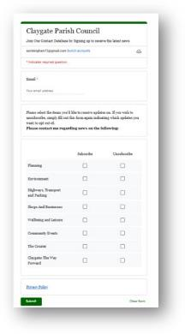
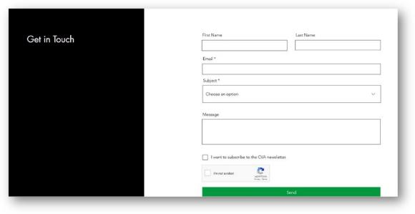
CPC Website I Managing Contacts
How we want to engage community members who want to hear from the CPC
  Currently, the Contact Form on the current CPC website is a very poor version to collect and manage contacts who have subscribed/unsubscribed
    It has no functionality whatsoever! If you add your details it disappears into the ether, and you hear nothing
    Mainly due to the fact there is no one tasked to respond to any request that is submitted.
  The Claygate Village association website (https://www.claygatevillageassociation.org/) uses standard WIX functions for collecting contact details via a form and then sending out relevant emailings to those who have subscribed.
    It’s exactly the same as Mailchimp, so all GDPR requirements are handled automatically and people can subscribe and unsubscribe without the need for anyone to do anything.
    Plus, you can set up automations to send acknowledgments etc.
  CPC needs a contact form with functionality similar to the CVA site.

Slide 9
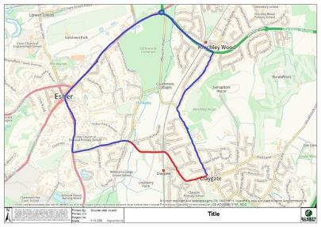
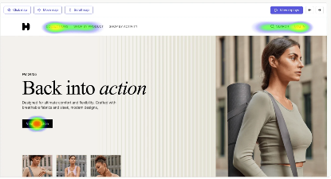
CPC Website I Other
Major Roadworks notifications
  Section to advise on any upcoming major roadwork notifications that impact the village
Include costs to add heatmap software to measure engagement across the site, so we can see what areas are being viewed and read the most.
  E.g. https://www.softwareadvice.co.uk/directory/4234/heatmap/software

Slide 10
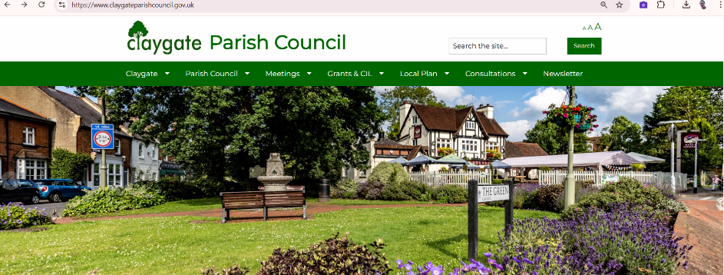
CPC Website I Next Steps
Agency to provide a cost for the site re-design
Agency to provide 12-month cost to update / manage site
Agency to advise on heat-mapping software costs
Timings & Requirements for go live
  Agency to supply a critical path to go live, showing dates
  Agency to advise what are CPC requirements (i.e. new articles etc)
  CPC can provide images where required

